Slide 1

Team Name
Brute_Force

Slide 2
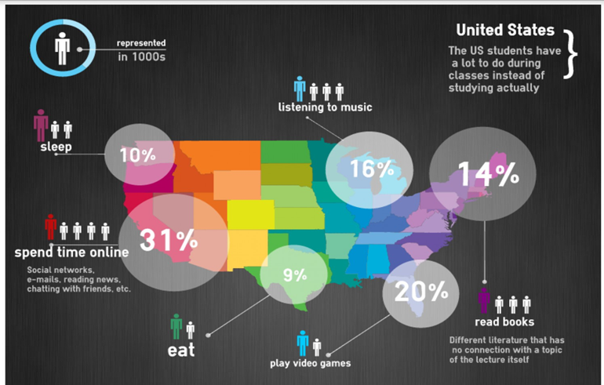
Why We Need This?
Today’s generation spend maximum of there time online. What if they make this time productive. This can be done by monitoring and measuring the attention span of the learners in the instructor led online sessions.

Slide 3
What We Want To Deliver
And why we are here….
Detection of eye movement
Using Python Libraries and Machine Learning techniques now we can easily detect the alertness of the student.
Plus
This can detect not only eye movement for drowsiness but also facial expressions, body movement (student leaving camera)

Slide 4
Advantages Of Our Technology
1
Focused Study Hours Will Gradually Increase
2
Self-discipline and responsibility
3
Opportunities to Scale
4
Greater Ability to Concentrate

Slide 5


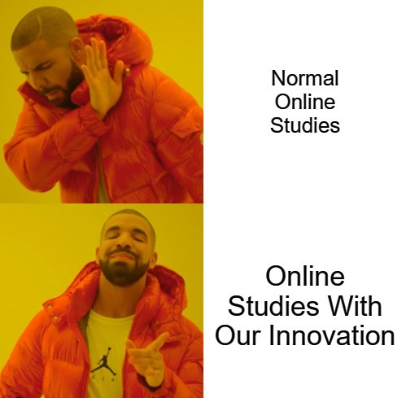


Slide 6
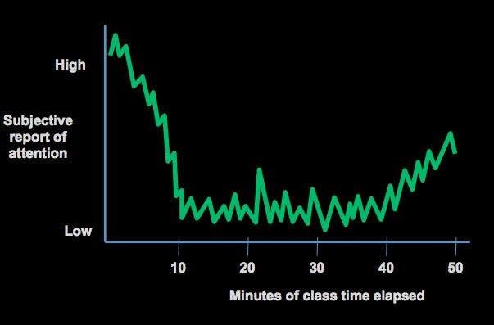
More About This Technology
By the time you finish your online course(with this technology), you will have gained more work experience and learned new skills.
In this project our team has made a website through which we can detect the student activity during online lectures.
As we now in our present times the children usually avoid online lectures due to many distractions during study like various games ,social sites and many other activities.
So our project will detect that the student will not able to close the eyes during study they may not feel asleep moreover they could not able to leave their respective positions.

Slide 7
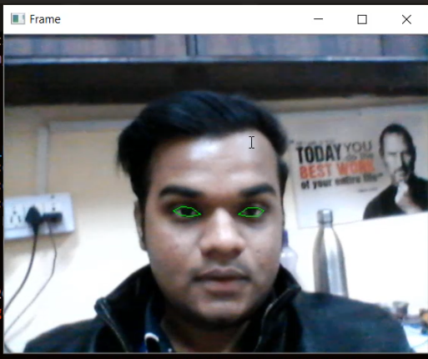
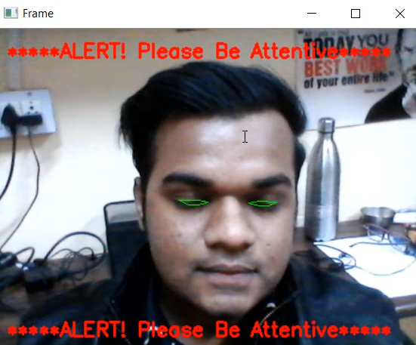
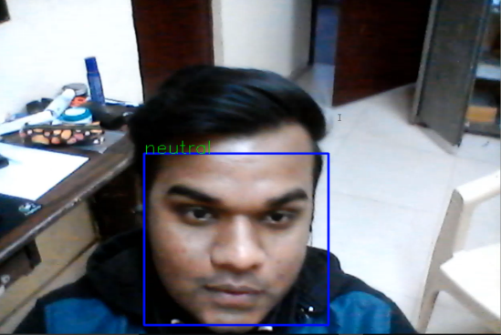
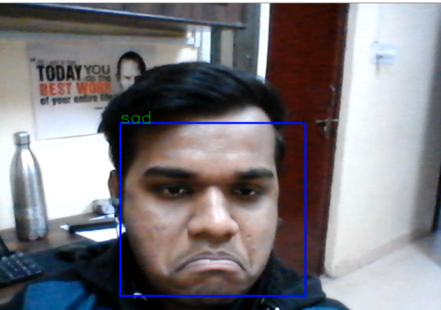
Working Model

Slide 8


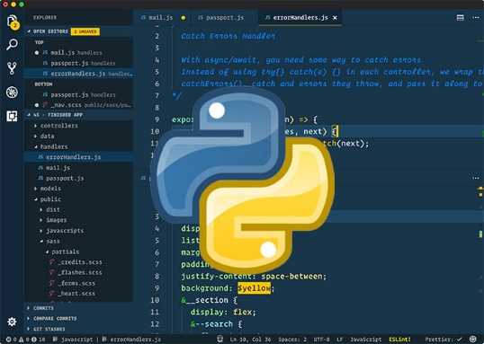



Libraries Used In Python
Dlib
Scipy
Imutils
OpenCV
Numpy

Slide 9

New Innovative Group Study With Friends
Friends Participation List
You will be able to see your friends while going through the course
Progress Report
A well analyzed report of your attentive study hours along with the report of your friends will make you more motivated and social.
Analysis your improvement graph
Day by day by using this technology the student will become more attentive, focused, discipline, punctual and moreover he will enjoy the class.
Techers will also get the report of every student and the teacher will try to make their lectures more effective, creative and interactive.

Slide 10
Any Question or Query
Feel Free To Ask

Slide 11
Our Team
Pranav Verma
Gunjan Kumar
Sagar Soneja
Arya College Of Engineering & IT
Thanks a million

